Slide 1
Microsoft Power BI

Slide 2
Building Solutions using Power Automate and the Power BI REST APIs
Ted Pattison
Principal Program Manager
Power BI Customer Advisory Team (PBICAT)

Slide 3
Welcome to Power BI Dev Camp
Power BI Dev Camp Portal - https://powerbidevcamp.net

Slide 4
ExportReportToFile - Developer Sample #1
https://github.com/PowerBiDevCamp/ExportReportToFile

Slide 5
Sample Power Platform Solution
replace

Slide 6
Agenda
Creating a Power Platform Custom Connector
Calling the Power BI REST API from Canvas Apps
Calling the Power BI REST API from Flows
Automating Administrative Tasks using Power BI Admin APIs

Slide 7
Introduction to Power Platform Custom Connectors not to be confused Power BI custom connectors
Enables Canvas Apps and Flows to call operations on custom web APIs
Custom connector defines actions which map to web API operations
Each operations includes details for calling one web API endpoint
Abstracts away details of acquiring access token for current user

Slide 8
Creating a Custom Connector
Power Platform supplies custom connector editor
Can be used to create custom connector from scratch
Custom connectors can be imported from various formats
Custom connectors can be exported and imported in JSON file format

Slide 9
Configuring Authentication for Custom Connector
Custom connectors support several kinds of authentication
Authentication is supported for users but not for service principals
Use OAuth 2.0 support for Azure Active Directory to call Power BI Service API
Requires creating Azure Active Directory application and configuring delegated permissions

Slide 10
Creating Azure AD Applications for Custom Connectors
You must create Azure AD application to call Power BI Service API
Azure AD application needs an app secret
Azure AD application needs to be configured with delegated permissions

Slide 11
Configuring Azure AD Application with Delegated Permissions
Configure your AAD application with delegated permissions you require
Different Power BI REST API calls require different permissions – figure out what you need
Optionally click Grant admin consent to eliminate consent prompt for users

Slide 12
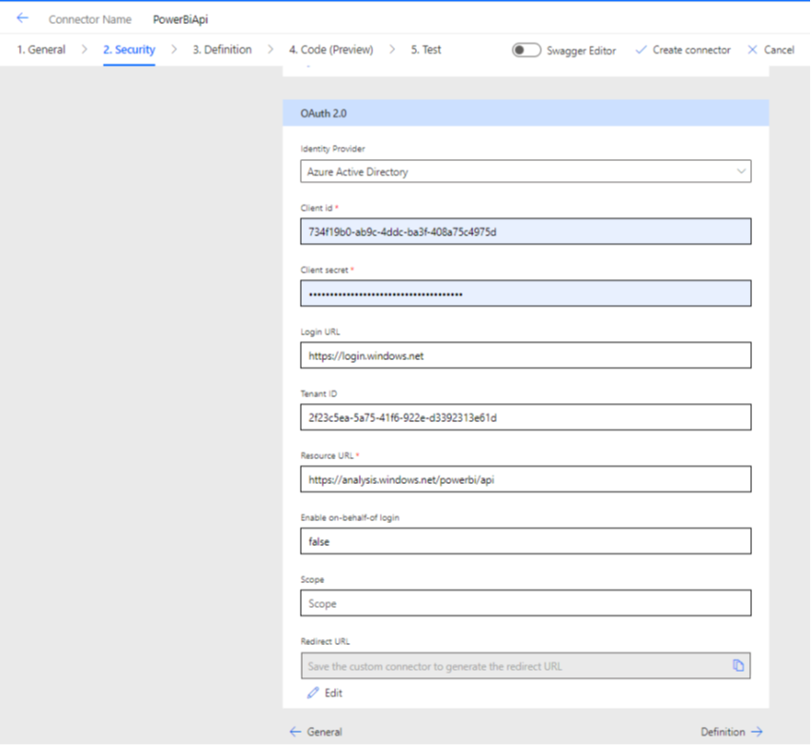
Power BI REST API Security Settings
Resource
https://analysis.windows.net/powerbi/api
Scope
Leave that textbox empty
.default used by default
Redirect URL
Leave blank
This will be added when you save connector

Slide 13
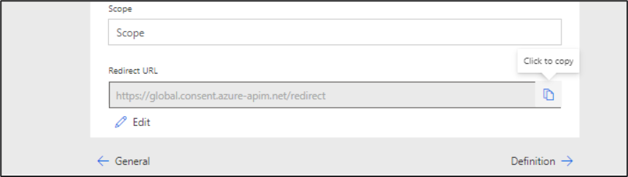
Power Platform Generates the Redirect URI
After you save the connector, the Redirect URL is assigned a value
Return to Azure AD portal and update Azure AD application with Redirect URL

Slide 14
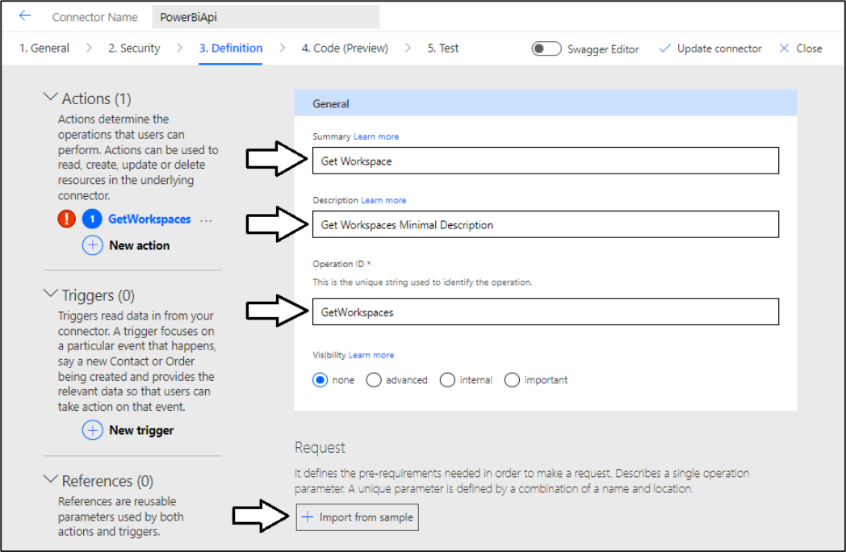
Creating a New Action
Go to Definition tab and click New action
Creating a new Action

Slide 15
Request - Import from sample
Verb – HTTP verb such as GET, POST, PUT, PATCH & DELETE
URL – endpoint which can contain Path parameters and Query parameters
Headers – headers sent with request
Body – HTTP request body usually sent in JSON format

Slide 16
Understanding Path Parameters
Sss
vvv

Slide 17
Response – Import from Sample
Response definition used to convert JSON into object
Import from sample provides quick way to create response definition

Slide 18
Creating Custom Connectors using the Swagger Editor

Slide 19
Power BI REST API Documentation
Leverage the Microsoft Docs for the Power BI REST API
https://docs.microsoft.com/en-us/rest/api/power-bi/

Slide 20
Agenda
Creating a Power Platform Custom Connector
Calling the Power BI REST API from Canvas Apps
Calling the Power BI REST API from Flows
Automating Administrative Tasks using Power BI Admin APIs

Slide 21
Agenda
Creating a Power Platform Custom Connector
Calling the Power BI REST API from Canvas Apps
Calling the Power BI REST API from Flows
Automating Administrative Tasks using Power BI Admin APIs

Slide 22
Calling a Custom Connector Action from a Flow

Slide 23
Executing a Flow from a Canvas App

Slide 24
Calling the Power BI REST API as Service Principal
xxx

Slide 25
Agenda
Creating a Power Platform Custom Connector
Calling the Power BI REST API from Canvas Apps
Calling the Power BI REST API from Flows
Automating Administrative Tasks using Power BI Admin APIs

Slide 26
Summary
Creating a Power Platform Custom Connector
Calling the Power BI REST API from Canvas Apps
Calling the Power BI REST API from Flows
Automating Administrative Tasks using Power BI Admin APIs

Slide 27
Agenda
Creating a Power Platform Custom Connector
Calling the Power BI REST API from Canvas Apps
Calling the Power BI REST API from Flows
Automating Administrative Tasks using Power BI Admin APIs

Slide 28
Microsoft Power BI
Questions?

Slide 29
Comparing Power BI Reports to Paginated Reports
Export API supports exporting Power BI Reports and Paginated Reports
Power BI Reports support exporting as PDF, PPTX and PNG
Paginated Reports support many additional output formats
Power BI Report Formats
Paginated Report Formats

Slide 30
There are three API calls required to export a report
ExportToFileInGroup
Starts asynchronous export job
Returns an Export object with the ExportID
GetExportToFileStatusInGroup
Call requires passing ExportID to return updated export object
Export object tracks Status with values of NotStarted, Running, Succeeded and Failed
Export object also tracks PercentComplete, ReportName, ResourceLocation, ResourceFileExtension,
GetFileOfExportToFileInGroup
Returns a file stream for image file from successfully-completed export job

Slide 31
Exporting a Report with the API - Play by Play
Custom Application
Power BI REST API
ExportToFileInGroup - https://api.powerbi.com/v1.0/myorg/groups/{WorkspaceId}/reports/{ReportId}/ExportTo
async export job
started
GetExportToFileStatusInGroup
async
export job completed
GetExportToFileStatusInGroup
Exported
File
Exported
File
GetFileOfExportToFileInGroup

Slide 32
C# Starter Code for Exporting a Report
Create ExportReportRequest object
Call ExportToFileInGroup
Call GetExportToFileStatusInGroup
Call GetFileOfExportToFileInGroup

Slide 33
Exporting Paginated Reports
ExportReportRequest contains PaginatedReportExportConfiguration property
Allows caller to include format settings
Allows caller to pass parameters defined in paginated report
Allows caller to pass user identity for row-level security

Slide 34
App-Owns-Data Export Sample Architecture
JavaScript Code
running in Browser
C# code running in
Custom Web API
Power BI REST API
ExportFile – Custom Web API
synchronous
blocking call
ExportToFileInGroup
asynchronous
non blocking call
GetExportToFileStatusInGroup
Exported
File
Exported
File
Exported
File
ExportFile API Response
GetFileOfExportToFileInGroup

Slide 35
Export To File for Power BI Report Action
Power Automate provides built-in actions –
Export To File for Power BI Report
Export To File for Paginated Report
Actions enable exporting reports and saving image file to SharePoint, Azure, etc.

Slide 36
Calling the Power BI REST API from Power Apps
Sample Power Apps solution for exporting Power BI reports
Demonstrates exporting report image files to SharePoint document library
Custom Connector
Power BI REST API
Canvas App
Get Groups
Get Reports in Group
Get Pages in Group
Export To File for
Power BI Report Action
Flow
Export to File in Group

Slide 37
Demo Building a Canvas App to Export Power BI Report and Paginated Report

